Slide 1

Capstone project
Case Study: How Does a Bike-Share Navigate Speedy Success?

Slide 2

Cyclistic Bike-Share
Presented by: Anupong Wongthotsarat
Updated: 15-Apr-2023

Slide 3
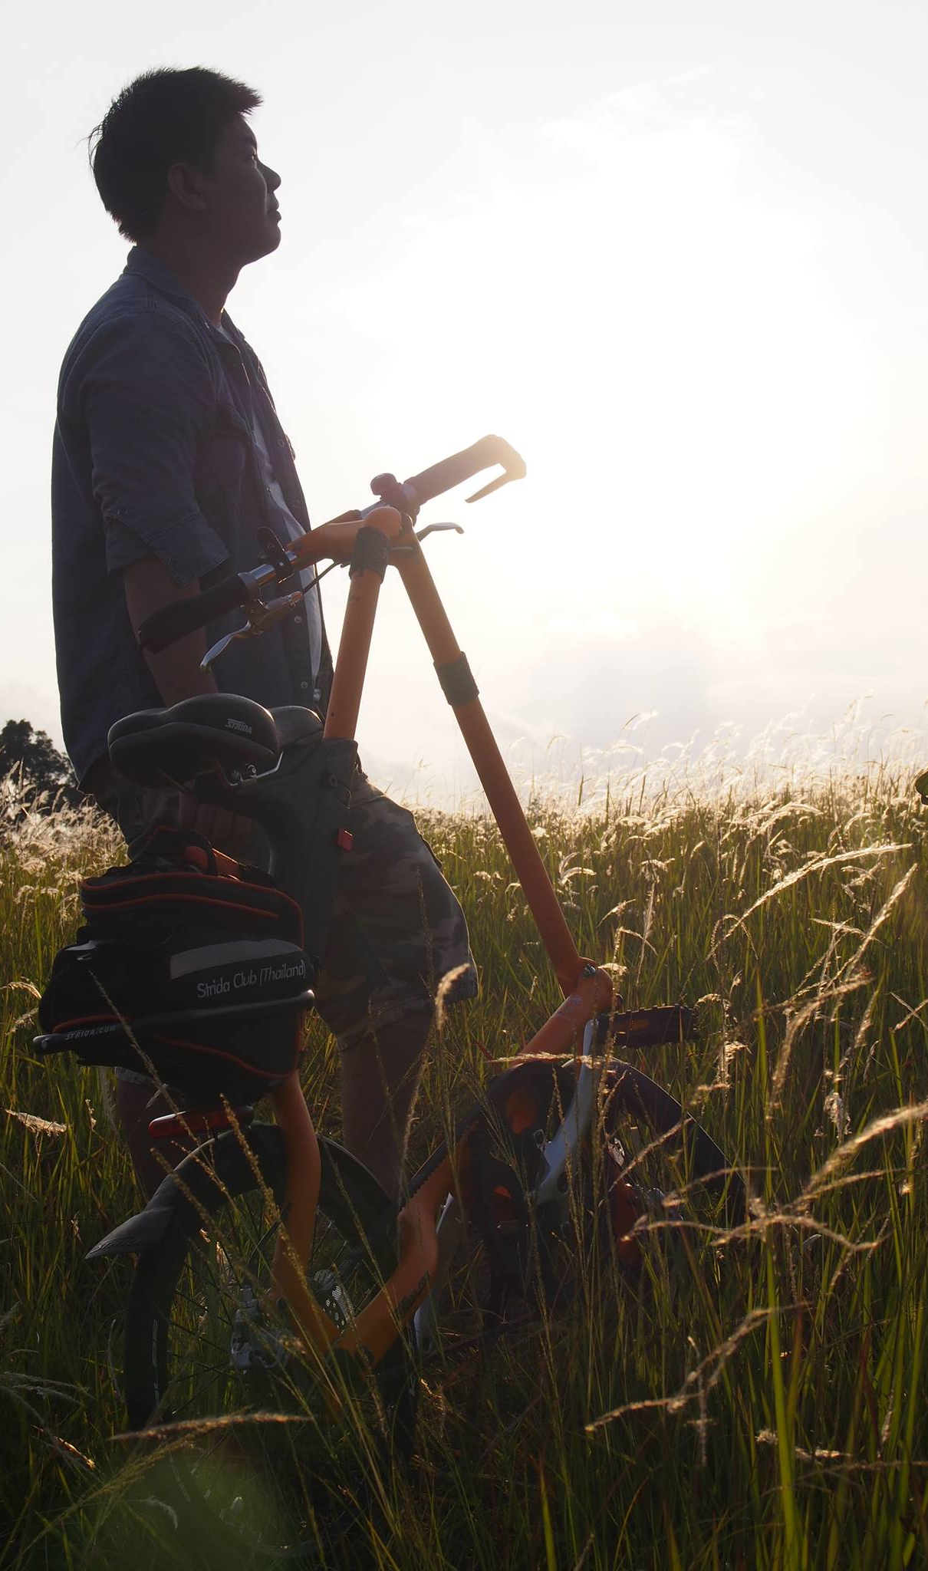
Contents
Objective
Data Insights
Key Takeaways
Recommendations
Appendix

Slide 4
Objective
To analyse how annual members and casual riders use Cyclistic bikes differently in order to determine the best marketing strategy to convert casual riders into annual members.

Slide 5
Data Insights
Determine data from period between April 2022 to March 2023 for this case study

Slide 6
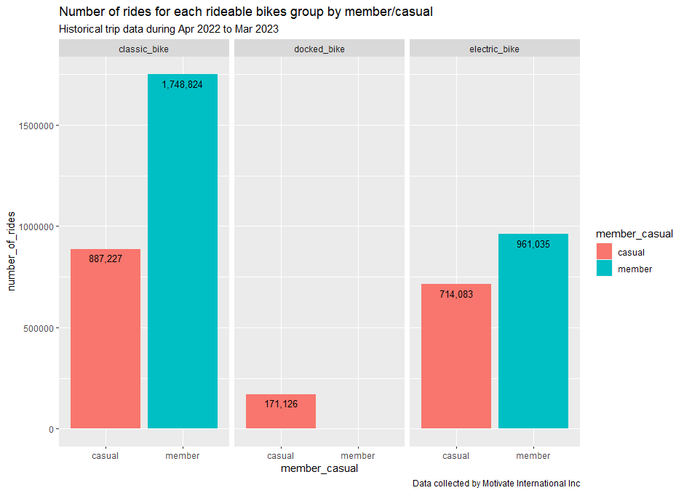
Insight#1 Rideable Bikes
Rideable Bikes group by Rider types
Classic Bike
  Members use classic bikes about 2x times than Casuals.
Electric Bike
  Members use electric bikes about 30% more than Casuals.
Docked Bike
  There is no Members use docked bike during period of investigation.

Slide 7
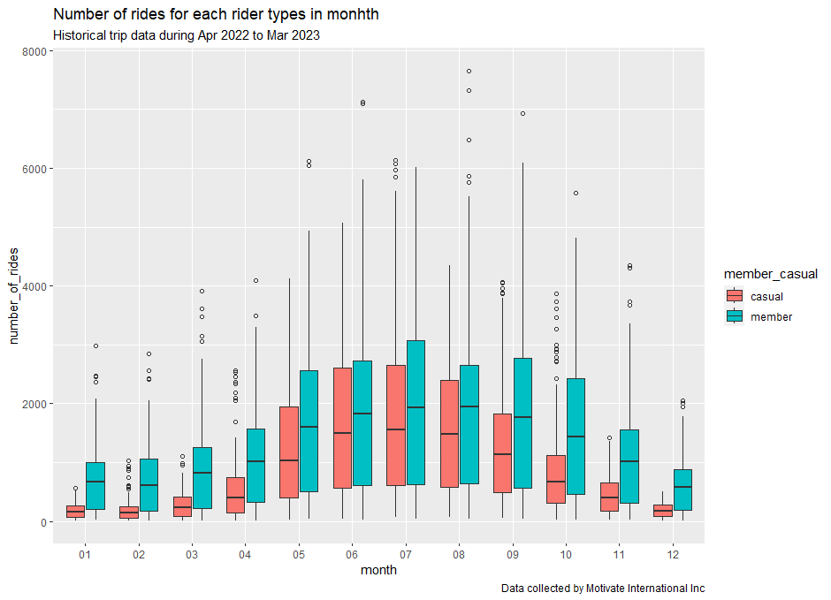
Insight#2 Rider types in each month
Rider types in each month
Number of rides in each month having the same trend that Members tend to ride more often than Casuals.
The low-season period between December to March can be identified as per relatively low on number of rides compared to other months

Slide 8
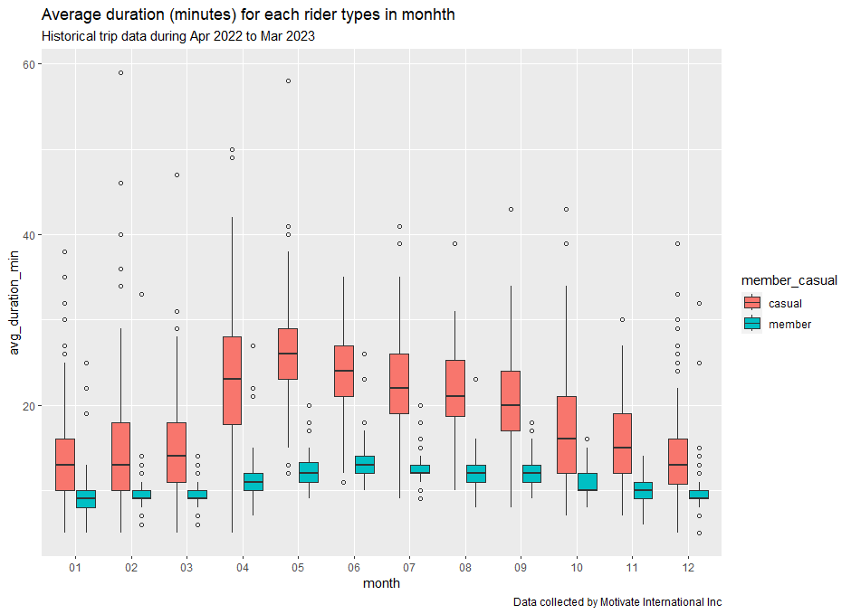
Insight#3 Average duration in each month
Average duration (minutes) in each month
Contrast to Number of rides (trips), Casuals tend to spend times on riding than Members.
Average duration for Casuals quartile#1 were greater than Members quartile#3 in every month.
Regardless the outlier, April – September, average duration for Casuals quartile#3 were greater than Members quartile#4

Slide 9
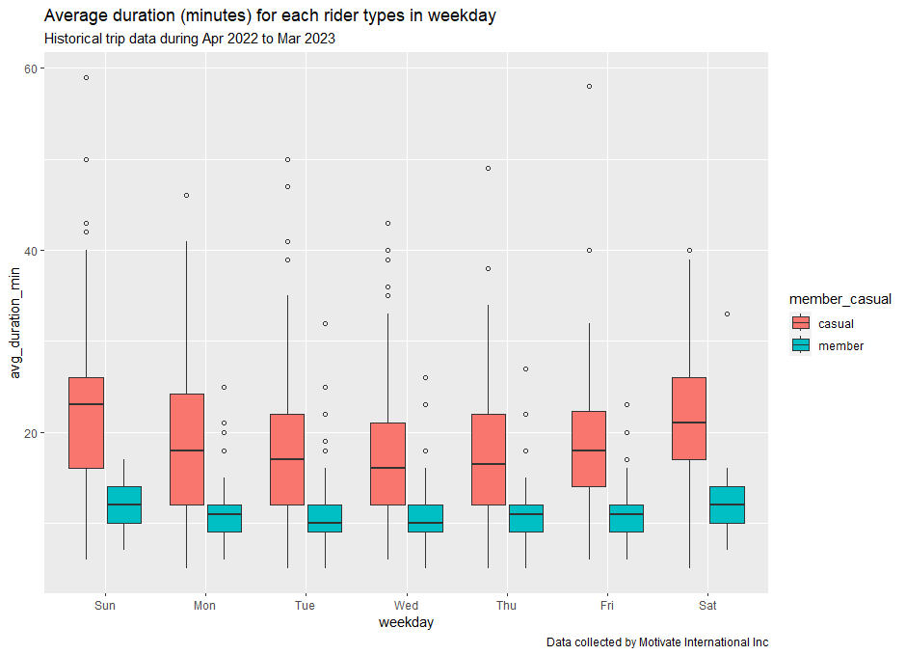
Insight#4 Average duration in each weekday
Average duration (minutes) in each weekday
Similar to average duration in each month, Casuals tend to spend times on riding than Members every day.
Average duration for Casuals quartile#1 were greater than Members quartile#3 in every day.
Regardless the outlier, average duration for Casuals quartile#2 were greater than Members quartile#4

Slide 10
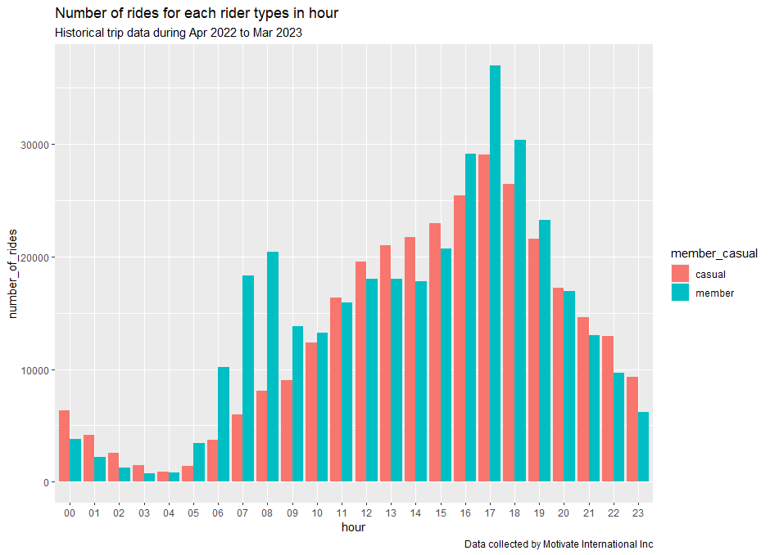
Insight#5 Number of Trips in Peak hour
Number of rides in each hour
Regardless monthly basis, all riders tend to ride during 3PM – 8PM
During 7AM – 9AM, Members tend to ride more than other period during day-time, except peak-hour period.

Slide 11
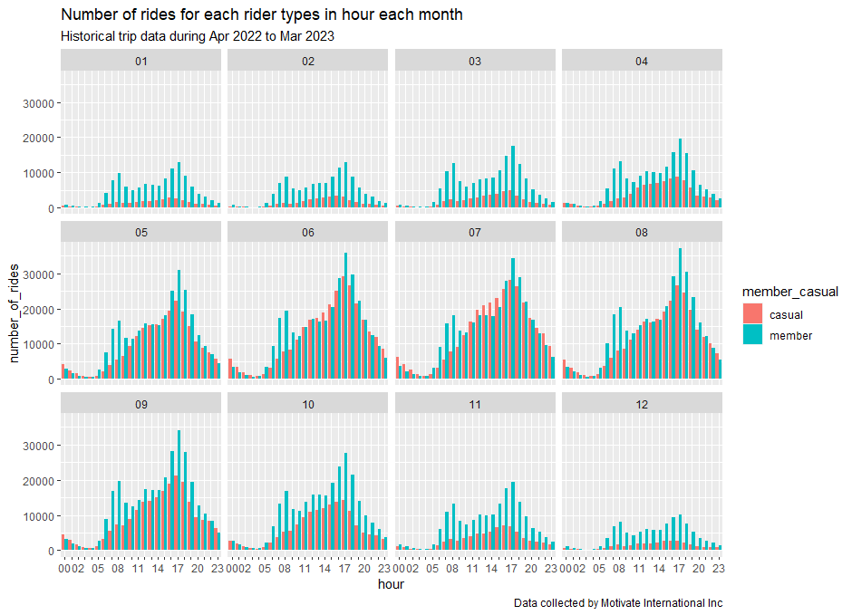
Insight#6 Num of Trips in hour each month
Number of rides in each hour per month
During May to September, number of rides (trips) in each hour for Casuals were comparable to Members

Slide 12
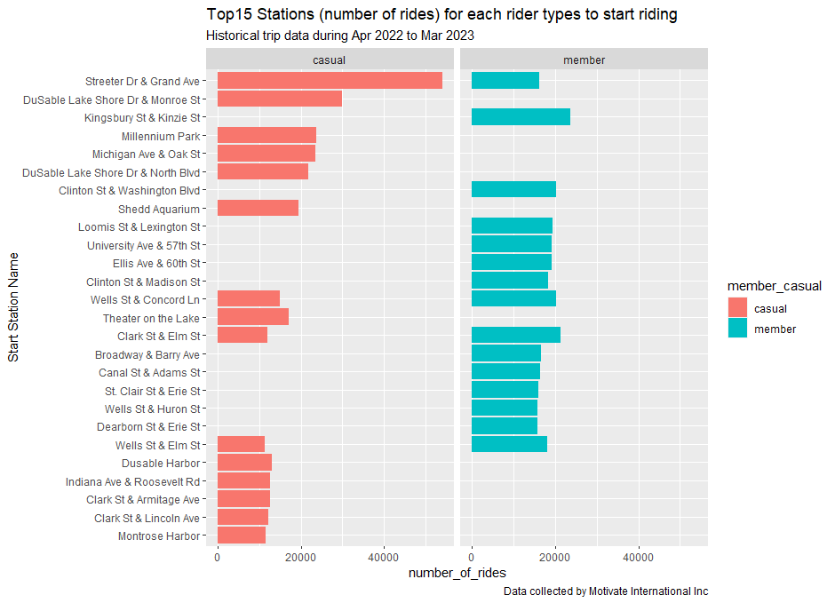
Insight#7 Top15 Started Stations both Riders
Top15 Stations for each rider types
List of most 15 used stations for both Members and Casuals.
There were 3 stations in the list where both Members and Casuals used the most.

Slide 13
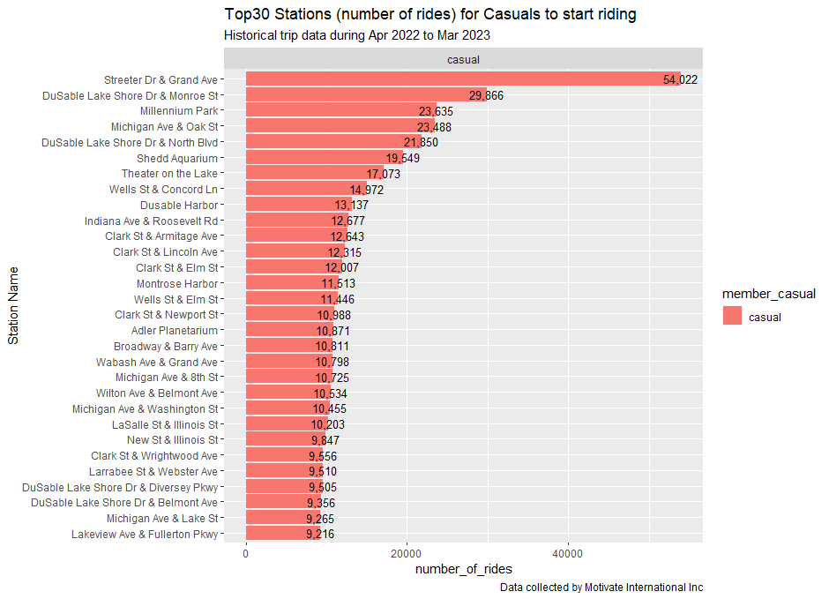
Insight#8 Top30 Started Stations Casuals
Top30 Stations for each rider types
List of most 30 used stations for Casuals.
There were 23 stations in the list where number of rides (trips) greater than 10,000 trips

Slide 14
Key Takeaways
Determine what we have got from insights

Slide 15
Key Takeaway
Overall, Casuals took less number of rides (trips) but spend much longer average duration in each trip.
Casuals contributed average duration in minutes higher than Members everyday
Casuals spent longest average duration in minutes during April to October
There were 3 stations out of Top15 stations where both Members and Casuals commenced their trips
Only Casuals rode on docked bike and they preferred on using Classic or Electric bikes (about 4 times higher than docked bike)
Top23 out of 30 stations for Casuals having started trips more than 10,000 trips in total 12 months

Slide 16
Recommendations
Determine what we have got from insights

Slide 17
Recommendations
Now we know that Casuals use bikeshare differently from Members, then we can:
Design riding packages based on casual riders behaviour such as
  3 or 6 months packages
  Morning, Afternoon or Evening packages
  All-You-Can-Ride/Unlimited ride packages
Start promoting/marketing at Top30(23) stations before official launch to all stations

Slide 18
Appendix

Slide 19
Appendix
Datasets
The historical dataset has been downloaded from here
The data has been made available by Motivate International Inc. under this license
Tool
RStudio

Slide 20
Thank You

